Slide 1
CAPSTONE PROJECT
ON HR ANALYTICS

Slide 2
AIM & OBJECTIVES
RECOGNIZE FACTORS INFLUENCING PROMOTION
UNDERSTAND OTHER VARIABLES DETERMINING THE PROMOTION
DEVELOP AN ACCURATE MODEL THAT CAN FORECAST THE PROBABILITY THAT AN EMPLOYEE IS EXPECTED TO BE PROMOTED.

Slide 3
Problem Statement
The client is facing a problem in identifying the right people for promotion (only for the manager position and below) and preparing them in time. The company needs help in identifying the eligible candidates at a particular checkpoint so that they can expedite the entire promotion cycle.
They have provided multiple attributes around Employee's past and current performance along with demographics. Now, the task is to predict whether a potential promote at the checkpoint in the test set will be promoted or not after the evaluation process.

Slide 4
Dataset Description
employee_id: Unique ID for the employee
department: Department of employee
region: Region of employment (unordered)
education: Education Level
Gender: Gender of Employee
recruitment_channel: Channel of recruitment for employee
no_of_trainings: no other training completed in the previous year on soft skills, technical skills, etc.
age: Age of Employee
previous_year_rating: Employee Rating for the previous year
length_of_service: Length of service in years
KPIs_met>80%: if Percent of KPIs(Key Performance Indicators) >80% then 1 else 0
Awards_won?: if awards won during the previous year then 1 else 0
avg_training_score: Average score in current training evaluations
is_promoted: (Target) Recommended for promotion

Slide 5
Import Libraries
# data analysis and wrangling
import pandas as PD
import NumPy as np
import random as rnd
# visualization
import seaborn as sns
import matplotlib.pyplot as plt
%matplotlib inline

Slide 6
Data exploration
Shape of train : (54808, 14)
Shape of test : (23490, 13)

Slide 7
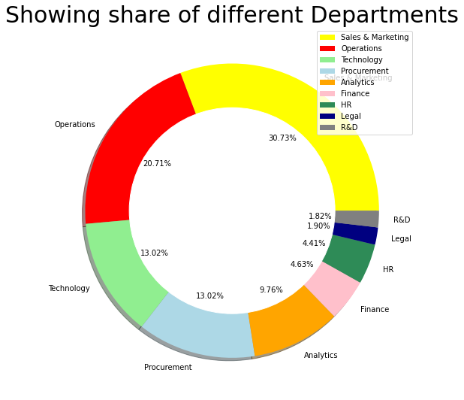
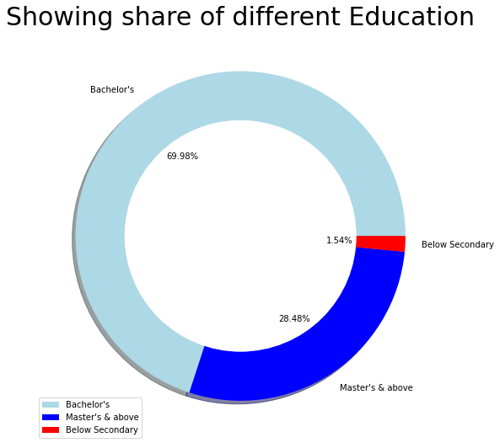
# plotting a donut chart for visualizing each of the department’s shares
# plotting a donut chart for visualizing each of the education shares

Slide 8
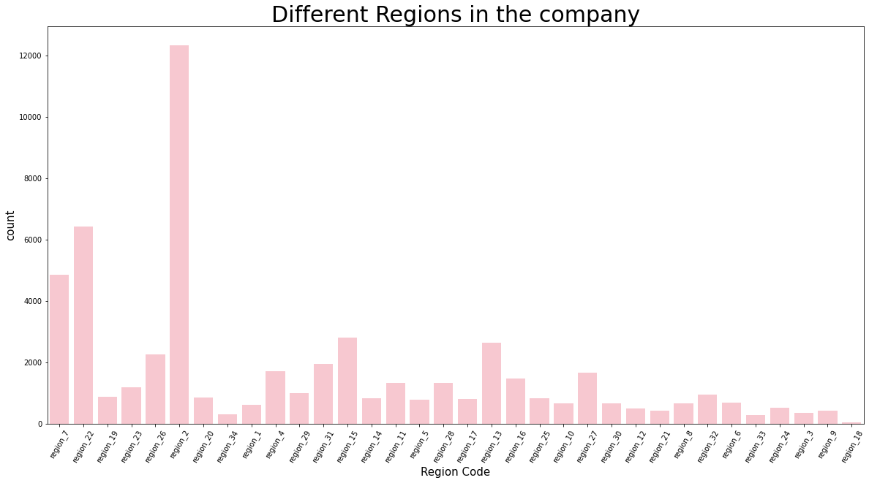
# checking the different regions of the company

Slide 9
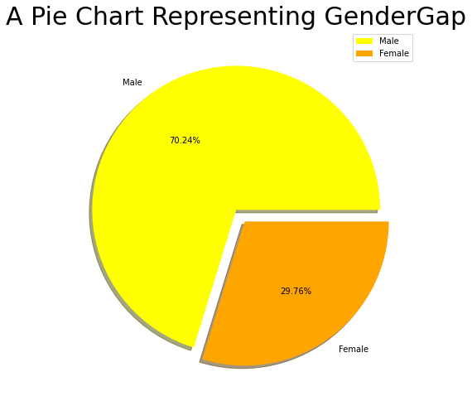
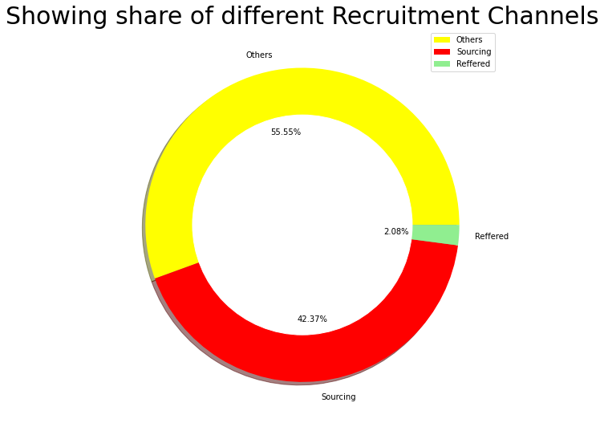
# plotting a pie chart
Gender: gender is a categorical variables with 2 categories: Male and Female.
# plotting a donut chart for visualizing each of the recruitment channel's share

Slide 10
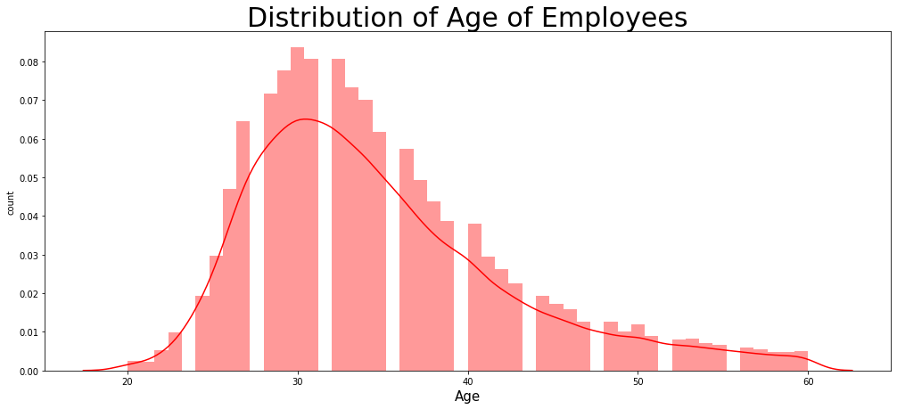
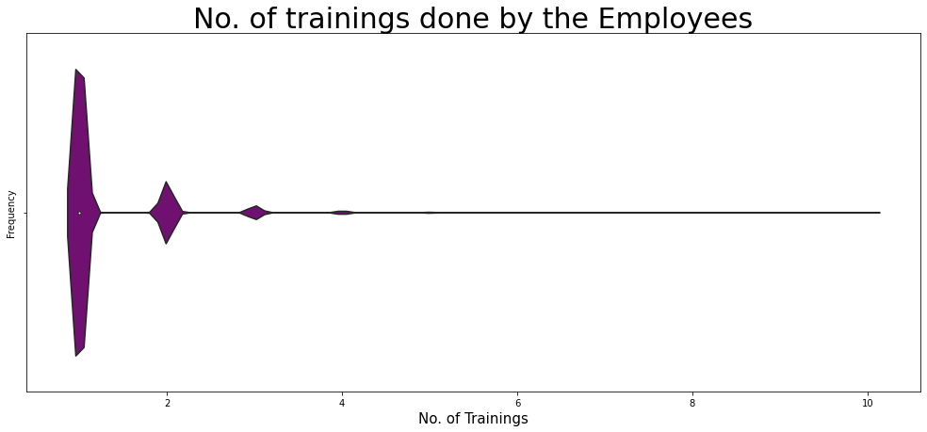
# checking the different no. of training done by the employees
# checking the distribution of age of Employees in the company

Slide 11
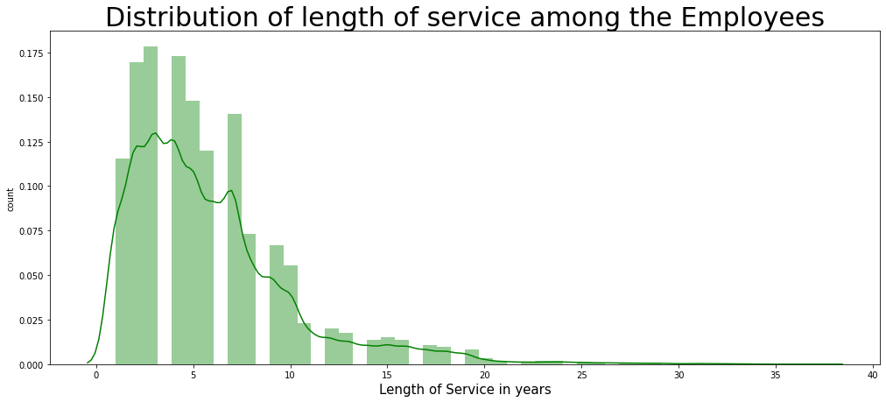
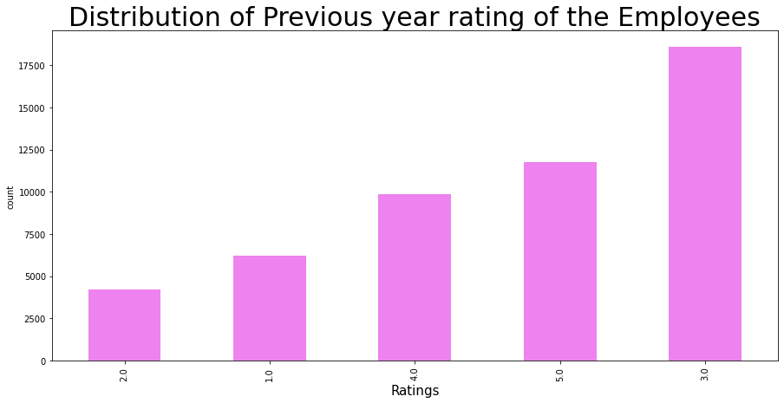
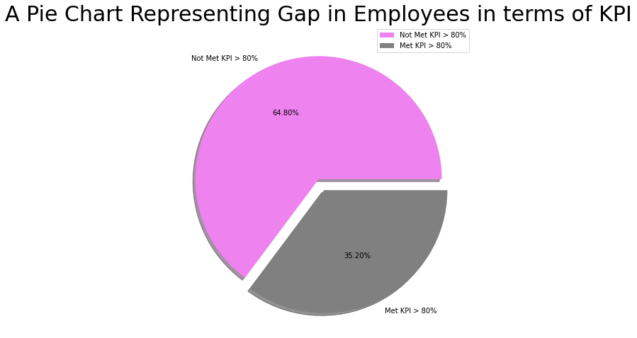
#Distribution of employees

Slide 12
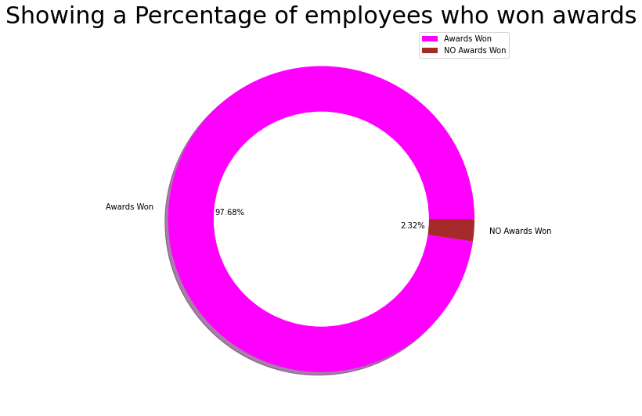
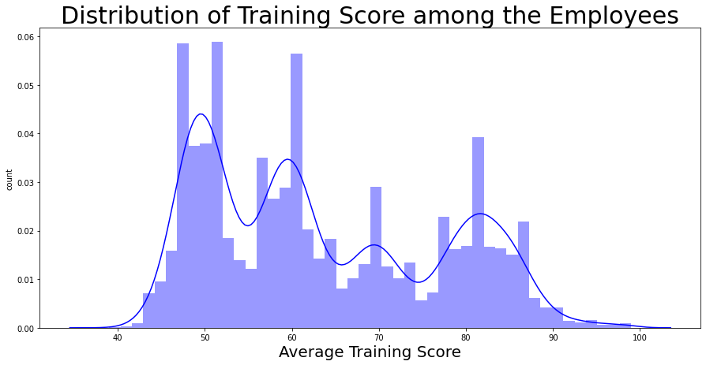
# checking the distribution of the avg_training score of the Employees
#plotting a donut chart for visualizing each of the recruitment channel's share

Slide 13
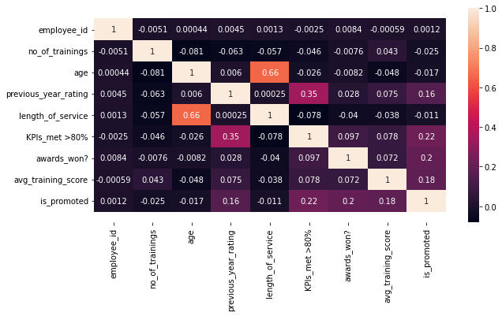
EDA
# Correlation matrix between numerical values

Slide 14
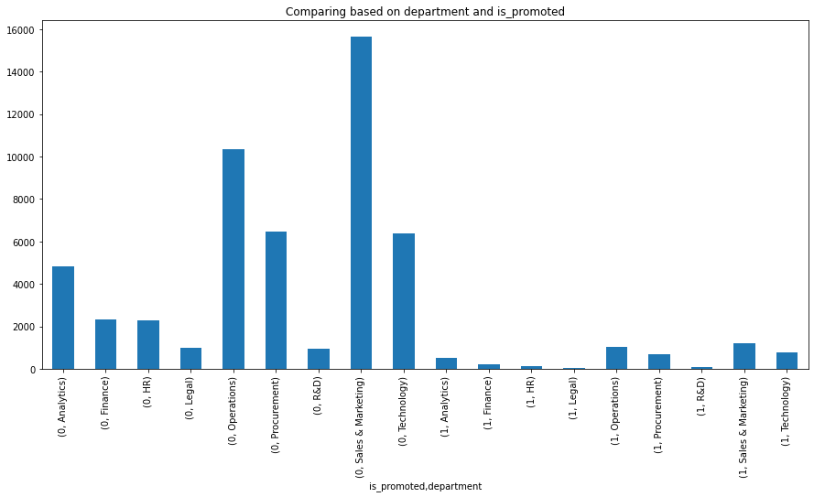
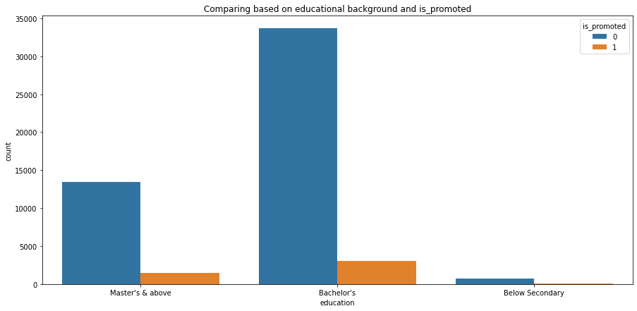
# A bar plot of is_promoted by Department
# Employees with which educational background have been promoted the most?

Slide 15
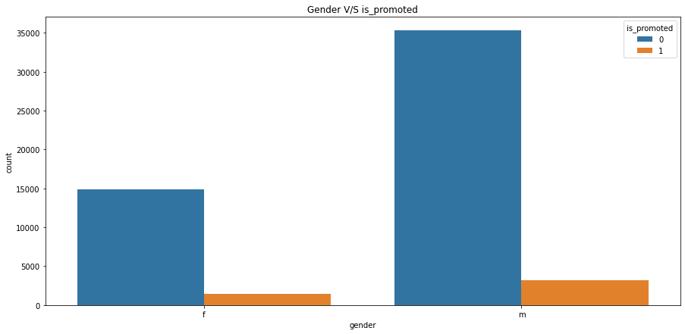
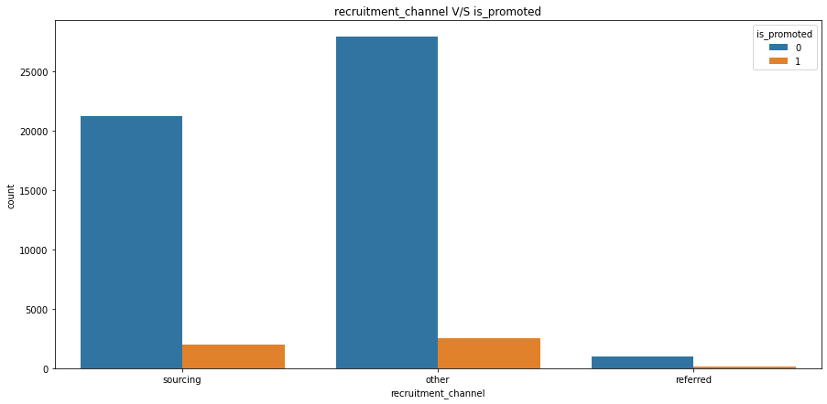
# Gender V/S is_promoted
#recruitment_channel V/S is_promoted

Slide 16
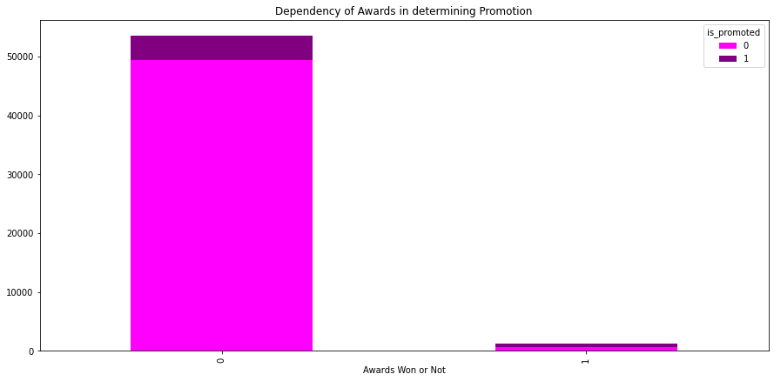
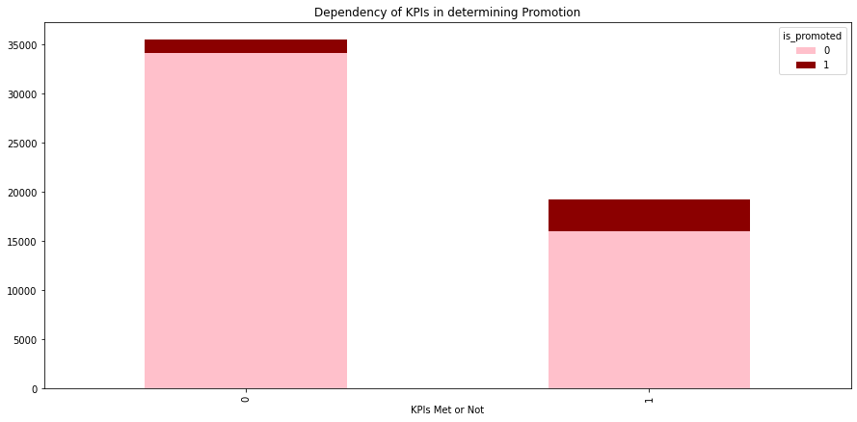
# dependency of awards won on promotion #dependency of KPI’s with Promotion

Slide 17
PRE-PROCESSING
ON THE ANALYSIS OF THE DATA IT CAN BE SAID THAT OUR TARGET VARIABLES SUFFERS FROM CLASS IMBALANCE PROBLEM AS THERE IS HUGE DIFFERENCE BETWEEN PROMOTED AND NOT PROMOTED
THIS CAN BE RESOLVED USING A TECHNIQUE CALLED SMOTE.
SMOTE ONE HOT ENCODER TRAIN TEST SPLIT

Slide 18
SMOTE
SMOTE – IS A COMMONLY APPLIED OVERSAMPLING APPROACH TO SOLVE THE IMBALANCE PROBLEM. IT INTENDS TO BALANCE CLASS DISTRIBUTION BY RANDOMLY INCREASING MINORITY CLASS EXAMPLES BY REPLICATING THEM.
ON APPLYING THIS TECHNIQUE TO VARIOUS CLASSIFIERS USING GRIDSEARCH CV WE FOUND THE BEST SPLITTING RATIO FOR OUR MODEL.

Slide 19
ONE HOT ENCODER
THE DATA TYPE OF THE VARIBLES SUCH AS GENDER , RECRUITMENT CHANNEL, AND EDUCATION IS IN OBJECT FROM THUS THERE IS A NEED TO CONVERT IT INTO NUMERIC FORM WITH THE MOTIVE OF FITTING THEM IN THE MACHINE MODEL
PANDAS GET DUMMIES WAS APPLIED TO CONVERT THE OBJECT VARIABLES INTO NUMERIC FORM.

Slide 20
TRAIN TEST SPLIT
THE DATA WAS SPLIT IN THE FOLLOWING MANNER:
DATA
TRAINING TESTING
70% 30%

Slide 21
MODEL SELECTION
AS THE DATA NOW HAS BEEN PROCESSED WE ARE COMPILED TO FIT THIS DATA INTO NUMEROUS CLASSIFIERS THAT DELIVERS THE BEST ACCURACY WITH F1 SCORE, PRECISION AND RECALL WITH THE BEST Roc-auc score
We have used five classifiers for training and testing or data and those are

Slide 22
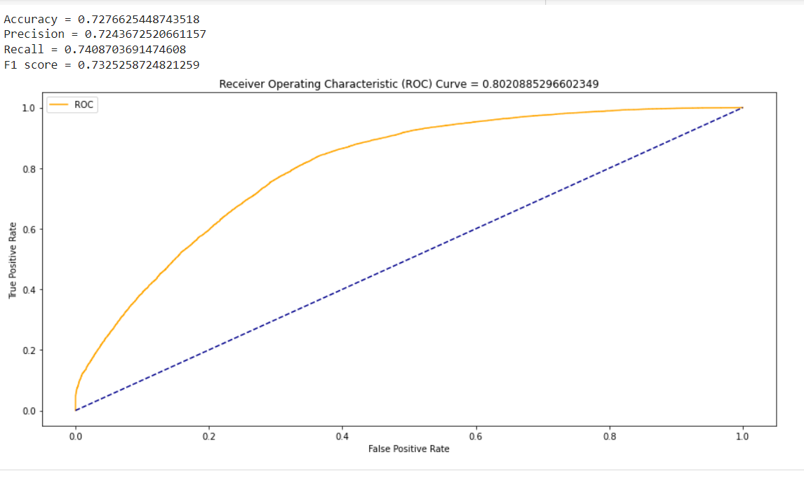
Logistic regression

Slide 23
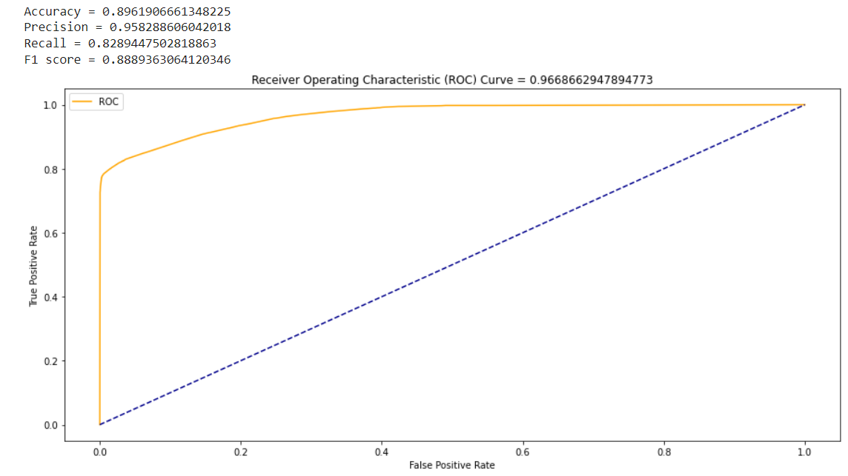
Decision tree

Slide 24
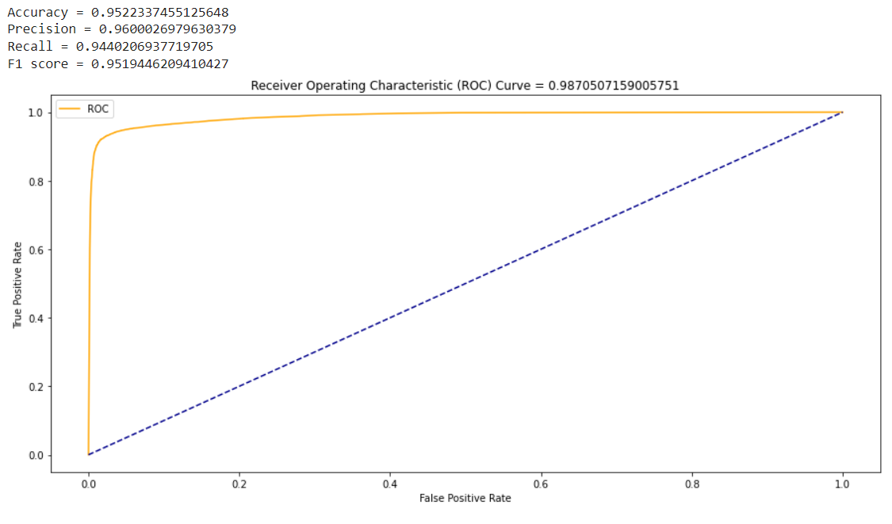
Random forest

Slide 25
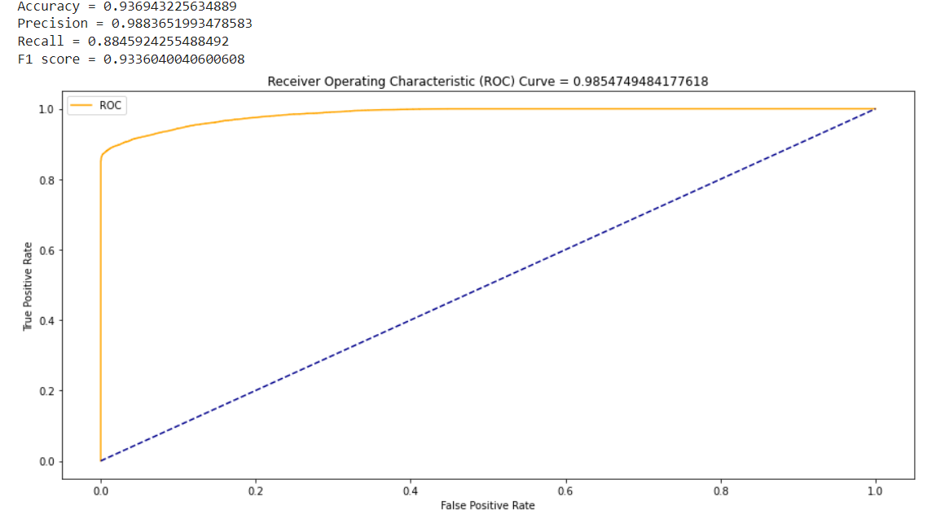
LGBM Classifier

Slide 26
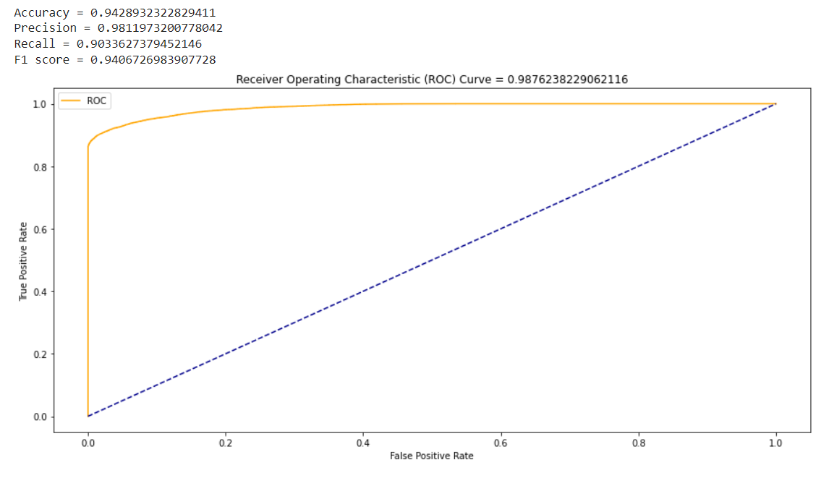
CatBoost Classifier

Slide 27

XGB Classifier

Slide 28
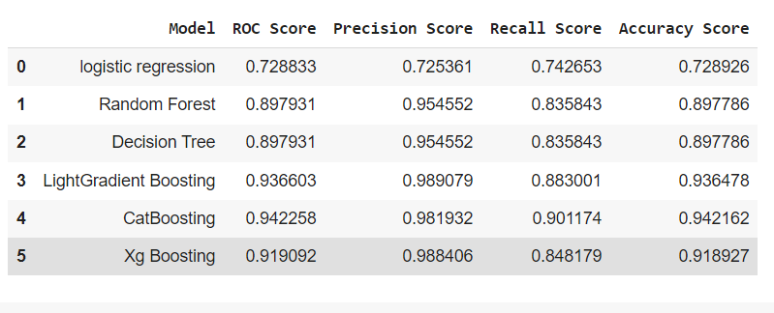

Slide 29
T H A N K Y O U
.

